Slide 1

Effect of higher Excise Tax on Smoking Behavior of Various Age Groups
GAURAV SHAHANE KUSHAL THAKKAR,
0627, MIM, FALL 2015

Slide 2

Smoking Kills..!!!
Smoking is the primary cause of preventable deaths in the US,
Killing an estimate of over 480,000 citizens each year.
Government has taken up several initiatives to curb death and illnesses caused due chronic use of cigarettes.
For example: Helplines, Mentorship programs , and more.
One of the reasons behind heavy taxes on cigarette is to discourage public from smoking.
We wanted to test if the taxes on Cigarette really have any effect on smoking population?

Slide 3
Research Questions
Is there a relationship between state level excise tax on a pack of cigarettes and % of cigarette smoking population in that state?
If yes, is the relation same to all age groups?
We are assessing Smoking Population in Age Groups as below:
18 – 24 years, 25 – 44 years, 45 – 64 years and more than 65 years of age
Why the analysis is important?
Deeper understanding of impact of heavy taxation on Cigarette on various age groups
Helping policy makers in evaluating the current tax policies in light of its relation with public health at large.
Better decision making to influence specific age group, which otherwise wouldn’t be impacted as much.

Slide 4
Data Cleaning
Datasets
Centers for Disease Prevention and Control (CDC) is a leading national public health institute.
CDC surveys and keeps track of various statistics related to many diseases.
We used the below datasets for our analysis:
Excise taxes on Cigarette packs from 1996
Behavioral Risk Factor Data – for Smoking
Conversion of file in CSV format for using in R
V Lookup for merging two datasets: Adding Excise Tax values to Smoking Population Dataset
Coding Excise Tax in Categorical variables for Factorial ANOVA test
Very Low | Low | Medium | High
0 – 25 percentile | 26 – 50 percentile | 51 – 75 percentile | 76 – 100 percentile

Slide 5
Statistical Tests
RQ 1: Is there a relationship between state level excise tax on a pack of cigarettes and % of cigarette smoking population in that state?
Correlation and Simple Linear Regression,
since we want to analyze relation between two ratio variables. Mainly, simple linear regression will provide best fit line that can be used for predicting smoking population.
RQ 2: If yes, is the relation same to all age groups?
Factorial ANOVA – Main Effect and Interaction,
since we want to explore interaction between the two variables and simultaneously, avoid the family error performing separate regressions for all the age groups

Slide 6
Descriptive Statistics
Mean Tax on Cigarette | $ 0.74 per pack
Minimum of Tax on Cigarette, all states, 1996 - 2010 | $ 0.00 per pack | In New York, 2007
Maximum of Tax on Cigarette, all states, 1996 - 2010 | $ 3.55 per pack | In New York, 2010
Minimum Smoking Population at any time | 9.1 % | In Utah, 2010
Maximum Smoking Population at any time | 32.6 % | In Kentucky, 2002

Slide 7
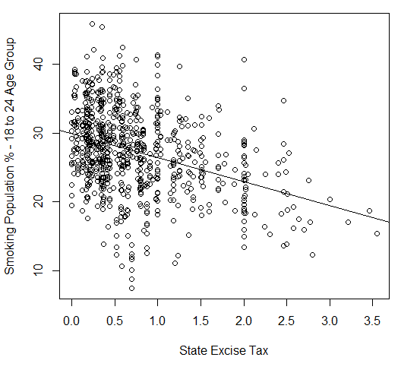
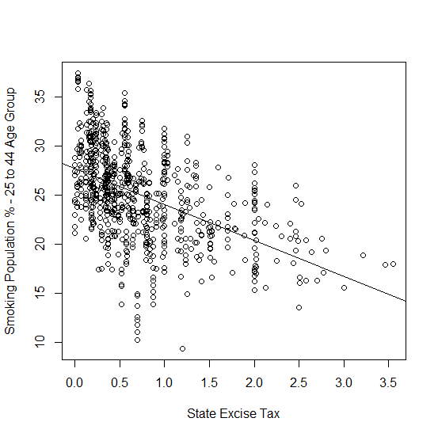
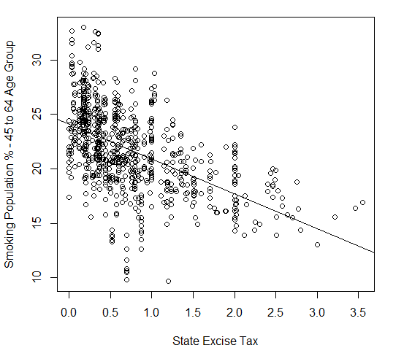
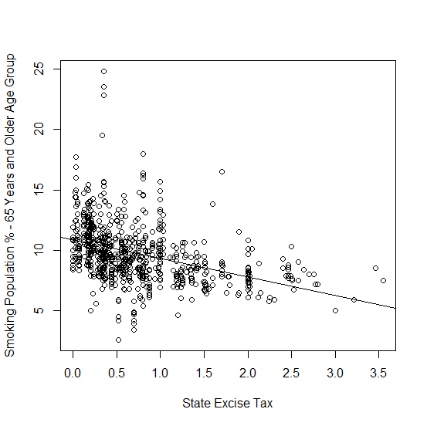
Exploratory
Data
Analysis
State Excise Tab
Vs
Smoking Population across various Age Groups

Slide 8
Hypothesis
Research Question 1. Is there a relationship between state level excise tax on a pack of cigarettes and % of cigarette smoking population in that state?
H₀: There is no relation between state level excise tax on a pack of cigarettes and % of cigarette smoking population in that state.
H_{a}: There is relationship between state level excise tax on a pack of cigarettes and % of cigarette smoking population in that state.

Slide 9
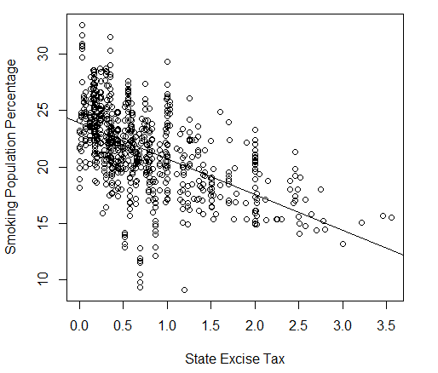
Result
Research Question 1. Is there a relationship between state level excise tax on a pack of cigarettes and % of cigarette smoking population in that state?
Null hypothesis rejected.
There is a negative correlation between Excise Tax and Smoking Population.
1 $ rise in Excise Tax on Cigarette will result in decrease in 3 % of smoking population
R Squared value ~ 0.3: means 30% of variance is explained by the State Excise Tax

Slide 10
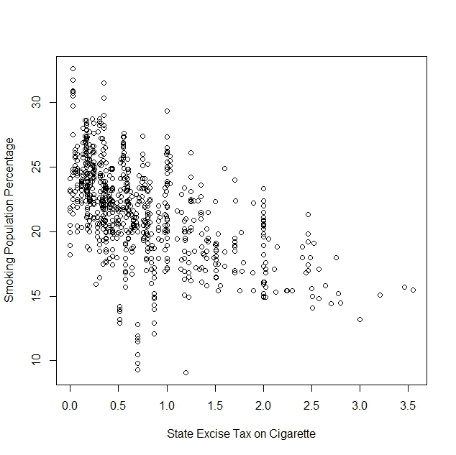
Assumptions and Limitations
Research Question 1. Is there a relationship between state level excise tax on a pack of cigarettes and % of cigarette smoking population in that state?
Restricted Range: The best fit line is applicable only for the limited range of data it has been drawn for
Linearity of data: The data is not very non-linear.
Outliers: There are a few outliers as shown in the scatterplot. They might affect the best fit line.
Causation: Correlation doesn’t imply causation. There could be other variables such as income, rehabilitation, or anything else that may have reduced smoking population.

Slide 11
Hypothesis
Research Question 2. If there a relationship between state level excise tax on a pack of cigarettes and % of cigarette smoking population in that state, is the relation same to all age groups?
H₀: Difference between means of % smoking population for different categories of State Excise tax are equal for all age groups.
H_{a}: Difference between means of % smoking population for different categories of State Excise tax is different for at least one pair of age groups.

Slide 12
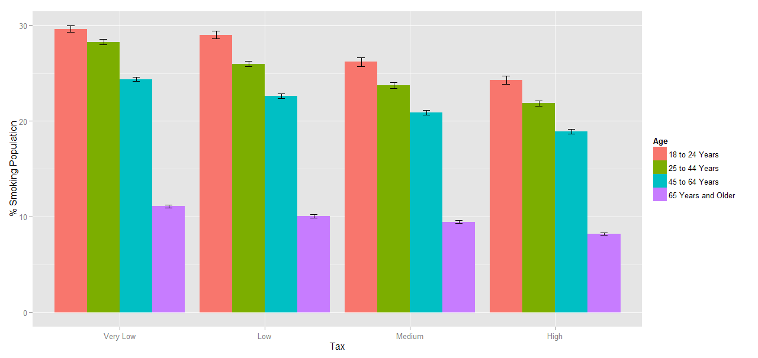
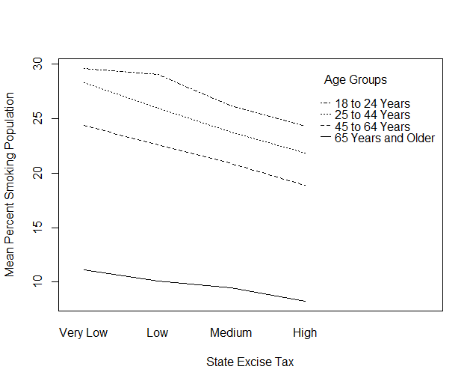
Result
Research Question 2. If there a relationship between state level excise tax on a pack of cigarettes and % of cigarette smoking population in that state, is the relation same to all age groups?
Null hypothesis rejected. There is difference in mean of percentage smoking population for at least one pair of age groups.
Interaction between State Tax Category and Age groups is significant.
Overall R Squared: 0.7529, means almost 75% of variance is explained this model.
Based on Linear regression, we observed that changes in Taxes affect most to the smoking population from age group 45 to 64 years.
The smoking population from age group 18 to 24 is least impacted by the changes in Taxes on Cigarette.

Slide 13
Box plot
Interaction Plot
Graphs based on Interactions between Tax and Smoking Population Percentage

Slide 14
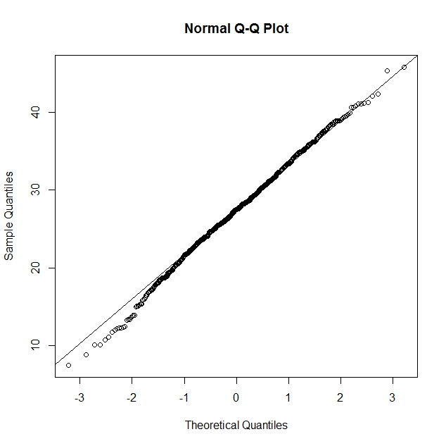
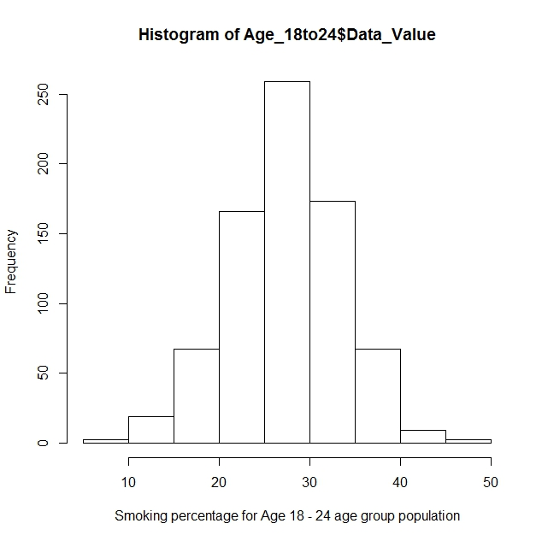
Assumptions & Limitations
Research Question 2. If there a relationship between state level excise tax on a pack of cigarettes and % of cigarette smoking population in that state, is the relation same to all age groups?
Normality:
The data is almost normal. Hence, the assumption is not violated.
Homogeneity of Variance
Levene’s test: Reject H_{0,} at least one variance is not equal
Assumption violated, but it is not so strict in this case
Independence of Observations:
The observed State Tax and Smoking Populations are independent of each other

Slide 15
Conclusions
Excise Tax on Cigarette and Percentage of Smoking Population are negatively correlated.
1 $ rise in Excise Tax on Cigarette packet will result in decrease in smoking population by approximately 3 %
Surprisingly, making cigarette expensive had the least effect on age group18 to 24 years, even though they might have the lowest income of all the age groups.
Alternatively, increase in taxes affected most to the smoking population belonging to age group 45 – 64 years, even though they might be earning more than any other age group.

Slide 16
Limitations
Better to have more than one variable to perform an all inclusive analysis of how significant is effect on Excise Taxes on smoking population.
The level of analysis was kept as states, and hence federal taxes on Cigarette have not been taken into consideration.
Scope for strengthening the analysis
We had to code State Taxes on Cigarette in Categorical Variable for conducting Factorial Interactions analysis. But invariably, it results in a loss. Is there any better way to perform the analysis keeping Taxes as Ratio variable only?

